Slide 1
Make your Next.js Sitecore site faster
Analyze and improve JavaScript bundle
Presented by: Anton Tishchenko
October 17, 2024
Notes:
Good morning!
Thank you for attending my session. Today we will discuss Next.js, Sitecore, and advanced techniques to make your website faster.

Slide 2
Speaker
Anton Tishchenko
CTO & co-founder of EXDST
11+ years of Sitecore experience
6-time Sitecore MVP
2023 Sitecore Hackathon winner
Former Sitecore employee
Sitecore Astro JSS toolkit creator
Notes:
First of all, let me introduce myself.
My name is Anton Tishchenko.
I am co-founder of Sitecore boutique development agency EXDST.
We are the Sitecore experts.
I have 11 years of Sitecore experience.
I was recognized as Sitecore's Most Valuable Professional in the last six years.
I, together with my team, won the 2023 Sitecore Hackathon.
And, probably, you have heard about me as the creator of Sitecore JavaScript Services Software Development Kit for Astro web framework.

Slide 3
Agenda
Bundlers
Webpack bundle analyzer
Sitecore styleguide analysis
Backend/frontend code in @sitecore/jss
Removing backend code from frontend bundle
Notes:
Today, we will discuss bundlers and how and why we started using them.
Then, we will move to bundle analysis and analyze the Sitecore Styleguide Next.js website.
Finally we will talk about frontend and backend JavaScript code separation.
And I will show you how to avoid the presence of backend code in your client-side bundle.

Slide 4
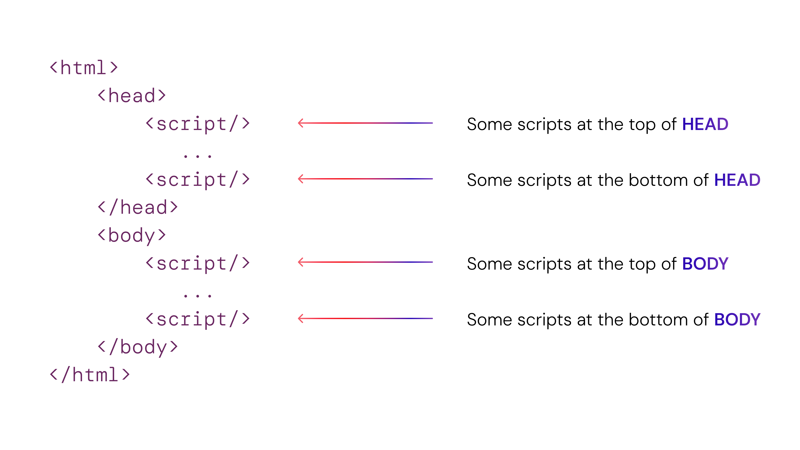
Old times
Notes:
Let's start!
Remember old times?
We needed to include scripts in HTML ourselves. We had the flexibility to put scripts where and how we wanted.
Some scripts were in separate files; some scripts were inline. The order of scripts mattered for both functioning and page speed.
It took additional time and effort, but you were in control of everything on your pages: when and how it is downloaded and executed.
Frontend complexity grew over time: CoffeeScript, TypeScript, Polyfills, JavaScript modules. It became too hard to control everything manually. ----

Slide 5
Bundlers
Notes:
Then bundlers appeared. They allowed you to merge your JavaScript code together into one file.
You became able to optimize, minify, and uglify the outcoming JavaScript.
Gulp was extremely popular in the Sitecore projects. It is more of a task runner than a module bundler, but it can bundle scripts.
It probably became so popular due to the usage of Gulp in Habitat(Remember that demo project?). Sometimes, it was even used to automate building .Net C# Helix projects, which was strange.
Gulp is still maintained and used on many projects. They released a new version this year, and Sitecore Experience Accelerator still depends on it.
Nowadays, the majority of React and Next.js projects use Webpack, and only pioneers use Turbopack. But in both cases, we don’t care about adding JavaScript to HTML. We have one entry point, use the `import` statement, and the bundler does everything by itself.
It gathers all dependencies and adds everything into one JavaScript file.

Slide 6
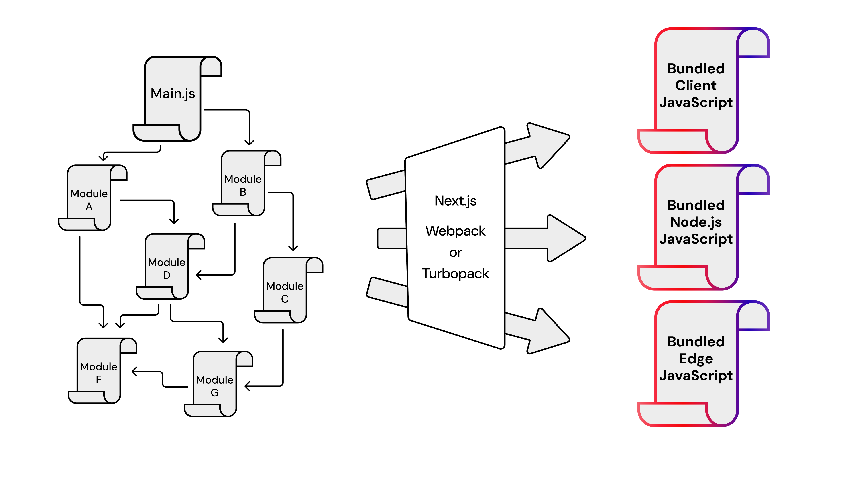
Bundlers
Notes:
Things become more complex with the Next.js framework. Part of your code is executed on the server side, and part in the browser. Next.js could be used in different modes: server side rendering, static site generation, and incremental static regeneration. Your JavaScript code could be executed during build time if you build pages in advance with SSG. It can be executed during runtime on the server if you use SSR or ISR. But also, your JavaScript code is executed in the browser. Also, there are two types of server runtimes: Node.js and Edge. You make requests to the layout service to retrieve page data on the server. All HTML for the first contentful paint is also prepared on the server.
But your carousel JavaScript works in the browser. Instead of one JavaScript bundle, you get three: client-side, Node.js, and Edge. But you use the same import statements for this code. Is Webpack smart enough to identify client-side code and server-side code during the preparation of bundles?
Let's figure it out. Spoiler: it is not. Otherwise, we would not have this presentation.

Slide 7
Sitecore styleguide Next.js client bundle analysis
Notes:
We need to use some Sitecore Next.js websites to check how bundling works. We can use the Sitecore Styleguide website.

Slide 8
Sitecore styleguide site
The first page that you see when starting a new headless project:
Notes:
You probably recognize this page. It is the first thing you see when you start the Sitecore project.
Sitecore provides style guide websites for Next.js, React, Angular, and Vue frameworks. It contains samples on how to use these frameworks together with Sitecore.
It is very convenient for our case as it doesn’t have any heavy front-end logic. We will be able to analyze the foundation of each Sitecore Next.js website.
How about analyzing it?

Slide 9
Next.js bundle analyzer
Terminal command to install the analyzer as NPM package npm i @next/bundle-analyzer
Configure bundle analyzer as Next.js plugin const withBundleAnalyzer = require('@next/bundle-analyzer’)({ enabled: true, openAnalyzer: true, }) module.exports = withBundleAnalyzer;
Notes:
There is an official recommended way of managing the size of your application bundle. It is @next/bundle-analyzer plugin.
We must install one npm package and add one configuration file that enables analysis.
Now, when we build our project, we will see this graph.

Slide 10
Sitecore styleguide Next.js client bundle
Notes:
We will see three graphs: one for the client side, one for Node.js, and one for Edge.
We are interested only in client-side bundle sizes because server-side bundle sizes don't affect page speed.
It is the graph for the client side. It looks fascinating but very unclear.
Let’s do some archeology and decompose what we see on this graph.

Slide 11
Sitecore styleguide Next.js client bundle
Notes:
The bundle contains a few chunks. We will go clockwise and check what we have.
The first one is the code of our Styleguide itself.
Yes, the truth of nowadays projects is that your code will be always the smaller part.
The libraries that you use will always be the more significant part.

Slide 12
Sitecore styleguide Next.js client bundle
Notes:
There are separate chunks for the 404 page, error page, and Next.js head management

Slide 13
Sitecore styleguide Next.js client bundle
Notes:
Big chunk for Next.js.
Here, for example, we have Next.js routing.

Slide 14
Sitecore styleguide Next.js client bundle
Notes:
And the chunk for React. As Next.js is the React meta-framework.

Slide 15
Sitecore styleguide Next.js client bundle
Notes:
The next chunk of dependencies contains @sitecore-jss libraries.
We will look at what is inside it.

Slide 16
Sitecore styleguide Next.js client bundle
Notes:
We will also go from right to left starting from the top right corner

Slide 17
Sitecore styleguide Next.js client bundle
Notes:
We have Next.js parts related to the links and images

Slide 18
Sitecore styleguide Next.js client bundle
Notes:
A lot of small dependencies.
Major of them are utils and polyfills that allows to run modern browser API in outdated browsers.

Slide 19
Sitecore styleguide Next.js client bundle
Notes:
But some of them probably are too big for their functions:
color-convert – that allows the conversion of color from one format to another
url-parse – allows parsing URIs
debug – I am not sure if it was intentional to leave debugging libraries in the final code We will leave them for another time

Slide 20
Sitecore styleguide Next.js client bundle
Notes:
We see the Sitecore frontend as a service package at the bottom left corner. It mostly consists of React.
And we already saw React in another chunk.
If there is someone from the Sitecore JSS team in this room, I think it is worth checking to avoid including React twice.

Slide 21
Sitecore styleguide Next.js client bundle
Notes:
Next big thing is @sitecore-jss, let’s check what is inside

Slide 22
Sitecore styleguide Next.js client bundle
Notes:
And again, we will go from the left to the right

Slide 23
Sitecore styleguide Next.js client bundle
Notes:
In the top left corner, we can see the implementation of Sitecore React components: Placeholder, Text, Date, EditFrame, etc.

Slide 24
Sitecore styleguide Next.js client bundle
Notes:
Some of the React components have different implementations for Next.js.
That is why, we ca see here Link, Image, RichText and others. By the way, if you look at @sitecore-jss Next.js and React field implementations, you will see that a major part of the code is related to Edit Mode. This means that we have code for Edit Mode here even if we are in Normal Mode.
That is one more idea for @sitecore-jss package improvements for JSS team.

Slide 25
Sitecore styleguide Next.js client bundle
Notes:
We can see different utils in the middle:
Editing, services wrappers, debug, etc.

Slide 26
Sitecore styleguide Next.js client bundle
Notes:
And the biggest part on the left is dependencies: graphql, graphql-request, axios, cross-fetch. But, hold on. We need these libraries to work with layout service. Do we make any request to the Sitecore Layout Service endpoint directly from the browser?
No, we don’t. These requests are done on the Next.js server side. We don’t need this part in our client-side bundle!

Slide 27
Sitecore styleguide Next.js client bundle
Notes:
Actually, the part that we don't need is even bigger. We don't need wrappers for graphql and axios, either.

Slide 28
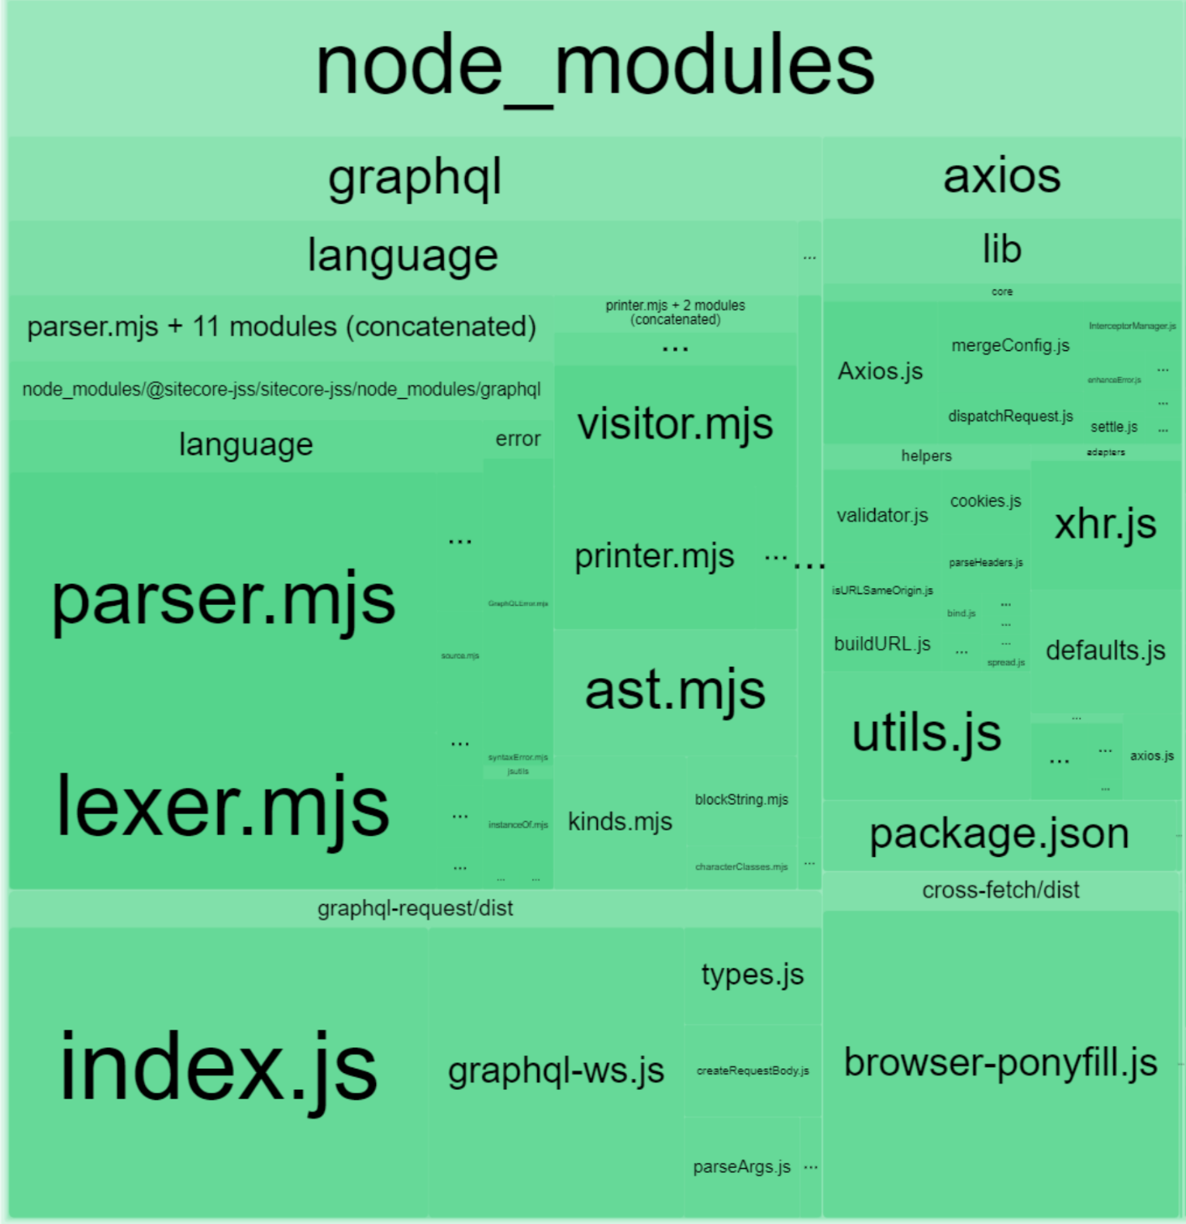
Sitecore styleguide Next.js client bundle
Notes:
We don't have a lot of time to touch everything.
Let’s decrease the scope for improvements on this presentation and figure out with dependencies!
Before starting the implementation of improvements, let’s check ourselves.

Slide 29
Bundlephobia @sitecore-jss/sitecore-jss
Notes:
There is a service named Bundlephobia. It shows you details, of what is inside npm packages.
The more you look at webpack analyzer graphs, the more you are afraid of adding something that you don’t need.
This service allows you to be more confident before running the npm install command.

Slide 30
Bundlephobia @sitecore-jss/sitecore-jss
Notes:
It confirms that the own code of @sitecore-jss is only 9 percent.

Slide 31
Bundlephobia @sitecore-jss/sitecore-jss
Notes:
Everything else is dependencies! Let’s focus on the biggest ones.

Slide 32
Bundlephobia @sitecore-jss/sitecore-jss
Notes:
I didn't use these libraries from the client side. But that was only my experience, and I decided to check myself.

Slide 33
Usage of Axios, GraphQL, and GraphQL-request on the client side
80%
10%
10%
Do not use them on client side
Make GraphQL requests via backend proxy
Use these libraries
Notes:
I made the poll in Sitecore Slack to check if my experience with using these libraries is similar to others.
Only 10% make graphql requests directly from the browser to Sitecore.
Another 10% use Next.js backend proxy to avoid exposing Sitecore URLs and secrets.
And 80% don’t make requests from browser to Sitecore using JavaScript. It means that the majority of Sitecore implementations don’t need these dependencies in the client-side bundle.

Slide 34
Removing server code from client-side bundle
Notes:
If we don’t need something, we can remove it.

Slide 35
Excluding server packages from client bundle in Next.js
Split your code into server and client-side parts
Hacks
"Monkey-patching" of content inside node_modules using some additional npm tasks
Hardcode node_modules folder content by adding it to Git
Webpack "alias" configuration
Notes:
We want to remove a few dependencies that are used on the server side but included in the client-side code. That is not too easy. We use dependency @sitecore-jss, and we can’t get rid of it. But we still have plenty of options.
1. Sitecore JSS is open source. We can fork it. Then, we can split @sitecore-jss into server and client libraries. It would be the best, but it will take a lot of effort to do it and support it.
2. We can use some hacks. Hardcode node_modules folder or remove part of dependencies during the build. It will look not pleasant.
3. And the best option for our case is the usage of Webpack alias configuration

Slide 36
Webpack alias configuration
webpack: (config, { isServer, webpack }) => { if (!isServer) { // <-- We check that webpack prepares the client side bundle config.resolve.alias = { ...config.resolve.alias, // We replace the original 'graphql-request' package with empty file 'graphql-request': path.resolve(__dirname, 'src/fake/graphql-request.js’), // Same for graphql 'graphql': path.resolve(__dirname, 'src/fake/graphql.js’), // Same for axios 'axios': path.resolve(__dirname, 'src/fake/axios.js’), }; } return config; }
Notes:
It will be quite easy. We check that Webpack prepares the client-side bundle. If it is preparing the client bundle, replace the original npm packages with fake JS files.
Instead of including the real npm package of graphql, graphql-request, or axios, we will include empty files.

Slide 37
Measure the potential savings
 | sitecore-jss | graphql | axios | graphql-request | imporoved size | % of initial size
Stat size | 287.2 KB | 113.11 KB | 48.95 KB | 42.66 KB | 82.48 KB | 28.7
Parsed size | 106.31 KB | 39.44 KB | 17.49 KB | 17.35 KB | 32.03 KB | 30.1
Gzipped size | 28.13 KB | 10.05 KB | 6.32 KB | 4.84 KB | 6.92 KB | 24.6
Notes:
The results will be different depending on the measured approach.
The Gzipped size is more straightforward to explain and understand. It is the size of JavaScript that will be transferred from server to browser.
We can see that we improved the size of the @sitecore-jss NPM package by a factor of four(fourfold improvement.), and that is not the limit.
It is the measurement of one library. Let's see the effect on the whole website.

Slide 38
Lighthouse results
 | Before | After
Total size | 130.5 KB | 108.9 KB
Chunk size | 75.7 KB | 54.9 KB
Notes:
We can do the real test with our changes using Lighthouse.
I like this tool, and BTW, 6 years ago, I created a Sitecore module that allows you to run Lighthouse reports directly from the content editor.
And we can see that with this small change, we saved 20kb.
That is not a lot, but that is 20% of the JavaScript.
And Lighthouse legend changed from critical to warning.

Slide 39
What next?
You can apply this fix to your project if you don't run any GraphQL queries on the client side.
Use Lighthouse and @next/bundle-analyzer to understand what is inside your bundle.
Get rid of unnecessary JavaScript code from your client-side bundle.
Notes:
Let’s sum it up!
If you don't make any graphql requests directly from the browser, you can apply this fix immediately to your Sitecore implementation. You will save some kilobytes, milliseconds, which will make your website faster.
But that wasn't the main point. The main point is that you should know what is inside your client-side bundle. We can see that a pair of Next.js + Webpack is not smart enough to identify and split the code that was used on the server and that was used on the client.
Now, you should know how to analyze your client-side bundle. Use Lighthouse and @next/bundle-analyzer to understand what is inside your bundle. And if there is something big and useless, get rid of it. And even if it is a dependency of your dependencies, it is still possible to remove it with Webpack alias configurations.
And don’t blame Sitecore for the presence of graphql and axios inside final Next.js client-side bundle. Sitecore JSS was created for React, Angular, and Vue. It was designed to be universal. There was no Next.js support at that time. It is not easy to split Sitecore JSS between server and client code, leave it universal for all frameworks, and remain backward compatible. But we as a community should leave feedback on things that we think can be improved.

Slide 40
Or just remove that 5MB hero banner image that no one really cares about anyway 🤣
Kamruz Jaman
Founder, Konabos Inc.
Notes:
And don’t forget, that you first need to optimize the most unoptimized things. And only then take care of fine-tuning.

Slide 41
Thank you
Contact us:
at@exdst.com
Notes:
Thank you for attention. You can find additional details, links, this presentation, when you scan the QR code. Now you can ask me questions!

